Slide 1

Rockbuster Stealth LLC Database Analysis
Annah mendrin

Slide 2
Project Overview
Rockbuster Stealth LLC is a movie rental company with plans to use its existing movie licenses to launch an online video service in order to stay competitive with the alternative streaming services on the market.
In order to move forward with the launch, several strategical questions must first be asked.

Slide 3





Key Questions and Objectives
Genre Analysis: Which movies contributed the most/least to revenue gain?
Rental Analysis: What was the average rental duration for all videos?
Spatial Analysis: Which countries are Rockbuster customers based in?
Customer Analysis: Where are customers with a high lifetime value based?
Sales Analysis: Do sales figures vary between geographic regions?

Slide 4




Rockbuster Statistics
Countries: 109
Customers: 599
Stores: 2
Films: 1000
Genres: 19
Languages: 6

Slide 5
Genre Analysis
Highest Revenue
Lowest Revenue
Genre | Revenue
Sports | $ 4,892
Sci-Fi | $ 4,336
Animation | $ 4,245
Drama | $ 4,118
Comedy | $ 4,002
New | $ 3,966
Action | $ 3,952
Foreign | $ 3,934
Games | $ 3,922
Family | $ 3,782
Genre | Revenue
Thriller | $ 48
Music | $ 3,072
Travel | $ 3,227
Children | $ 3,309
Classics | $ 3,353
Horror | $ 3,401
Documentary | $ 3,750
The top revenue producing genres include sports, sci-fi, and animation, closely followed by drama and comedy.
A closer focus should remain on movies within these genres to continue giving customers what they want to watch.

Slide 6
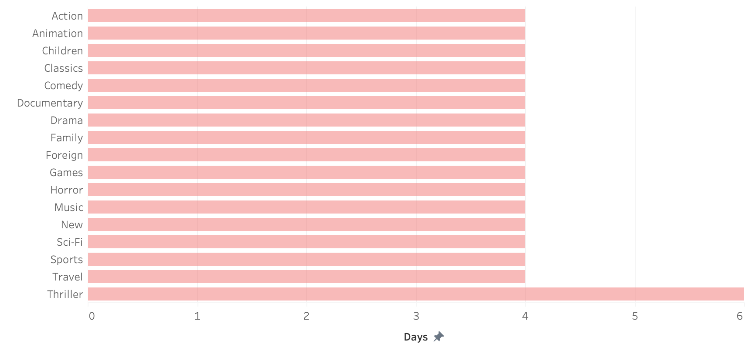
Rental Analysis
The average rental duration across all genres is 4 days, with the exception of Thrillers, which has an average rental duration of 6 days.

Slide 7
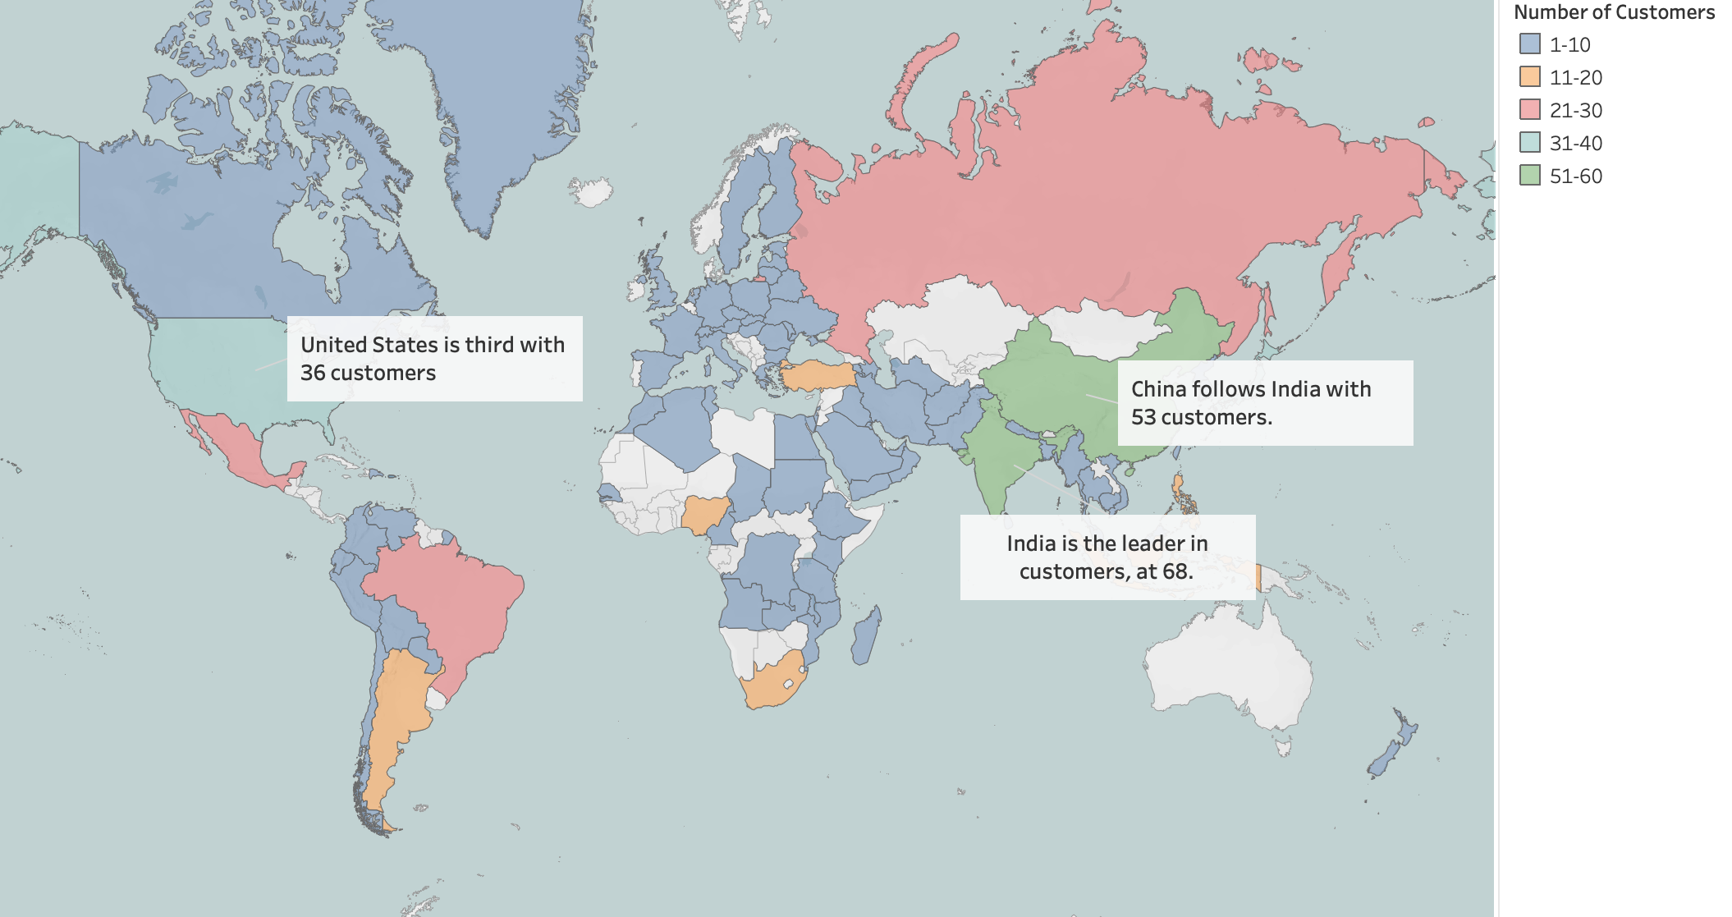
Spatial Analysis
Although there are customers spread throughout the world, the majority of Rockbuster’s customers are in populous countries such as India, China, and the United States.

Slide 8
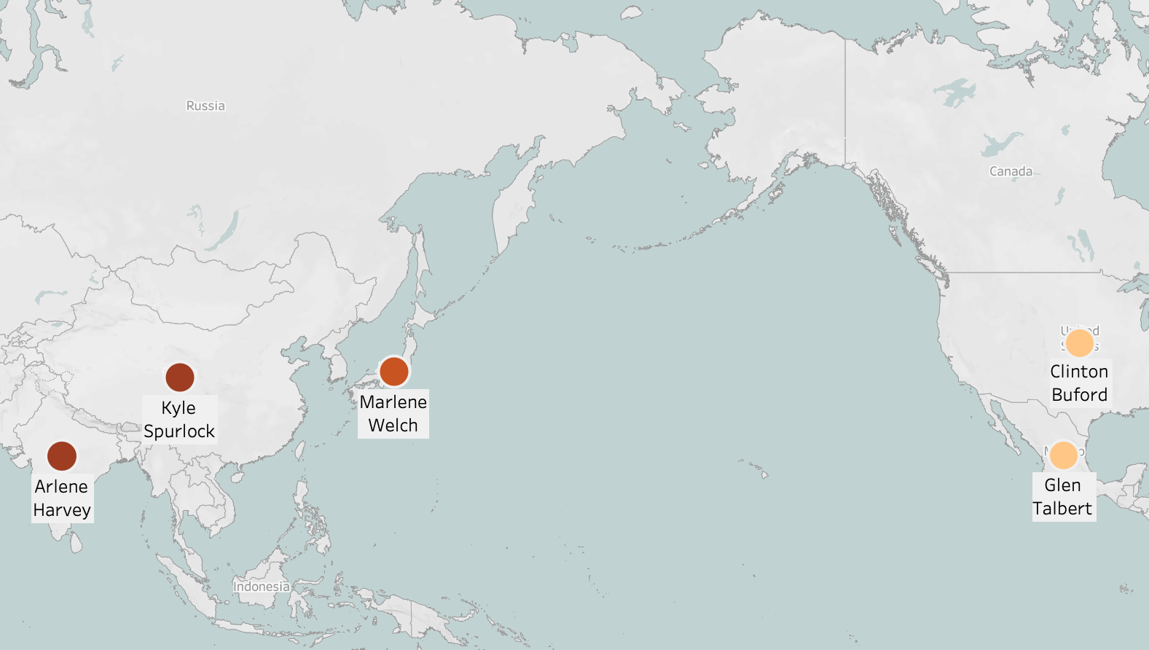
Customer Analysis
Customer | Country | Total Payment
Arlene Welch | India | $112
Kyle Spurlock | China | $110
Marlene Welch | Japan | $107
Glen Talbert | Mexico | $101
Clinton Buford | United States | $99
The customers with the highest lifetime value are spread throughout the world and should be rewarded for there loyalty to keep them returning to Rockbuster.

Slide 9
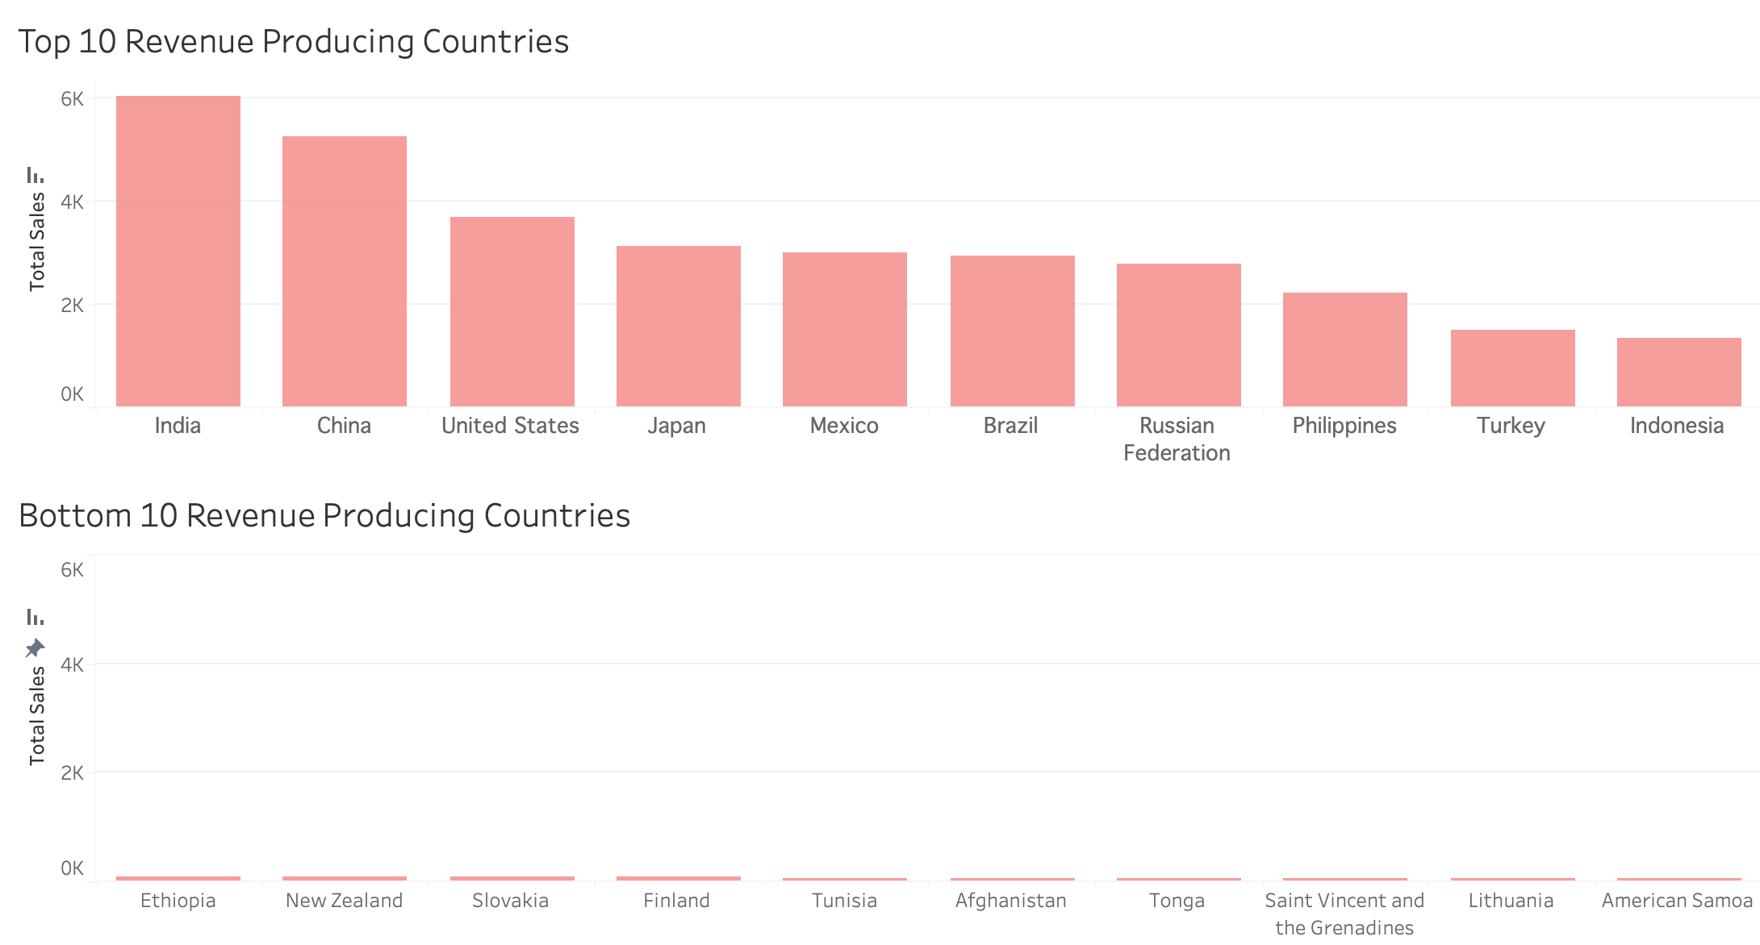
Sales Analysis
There are large gaps between countries with the highest revenue and those with the lowest.
The top 10 revenue producing countries make up 52% of the company’s total revenue, even though there are customers spanning 109 countries.

Slide 10


Recommendations
Genres
Continue to supply genres, such as sports, sci-fi and animation, that are universally popular amongst customers and will continue to be rented.
Locations
Focus on high revenue counties to continue to grow larger customer bases, as well as understanding why other countries are not using the platform.
Loyalty
In order to create a higher retention of customers, and keep them coming back for additional rentals, a loyalty program where customers may receive discounts or benefits for long-standing accounts can be utilized.
Further Analysis: Take focus on individual high revenue regions, such as the United States or India, to understand what genres they enjoy most, and continue to add to Rockbuster’s inventory accordingly.

